Slide 1
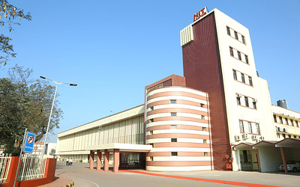

Team - TOXIC BREEZE
Problem Statement - 1
NIRF Analyzer: The Predictor and Enhancement Adviser

Slide 2
PROBLEM STATEMENT
NIRF ranks colleges in India based on various factors.
But manual NIRF rank tracking is slow. Analyzing college trends is time-consuming.
Solution: We are developing an automated platform using Machine Learning and Data Visualization for faster and enhanced Analysis for NIRF Rankings.

Slide 3
Key Technologies :
Python’s Streamlit library
Data Visualization using Power BI
Machine Learning
Streamlit using Python
A frontend platform is created using Python’s Streamlit Library.
ML Model
ML model trained using engineering institution ranks using NIRF data from 2016-2021.
Data Visualization using Power BI
Power BI was used to create an engaging and easily understandable visualization.

Slide 4



1. TRL (Teaching, Learning, and Resources): Teaching quality, Learning effectiveness, and Resource availability - 30% of the rank.
2. RP (Research and Professional Practice): Also 30% - Research productivity, Publications, Patents, and Industry collaborations.
3. GO (Graduation Outcomes): 20%, Students' Success post-graduation, including Job placements, Further education, and Income.
4. OI (Outreach and Inclusivity): 10% - Community Engagement, Diversity promotion, and Inclusivity efforts.
5. Peer Perception: Also 10%, Feedback from peers, Academics, and Public regarding an institution's quality and reputation.
5 KEY CRITERIAS

Slide 5
IMPROVED DATA ANALYSIS
1
Reducing time and effort.
PERFORMANCE TRENDS
2
Offering valuable insights.
RESULT
INFORMED DECISION-MAKING
3
Empowering institutions.
BROADER IMPACT
4
Enhancing higher education in India.
BENEFITS
5
Colleges and students will be benefitted.

Slide 6





Future
Scope
Using VR
Suggestion System
Immensely Scalable
Virtual Reality (VR) for faster and accurate online college inspections.
It can provide actionable recommendations for improving specific areas within an institution enhancing the overall quality of education.
The future scope of our product holds incredible promise. It's about enhancing higher education in India. It's about shaping the future of colleges and universities.

Slide 7
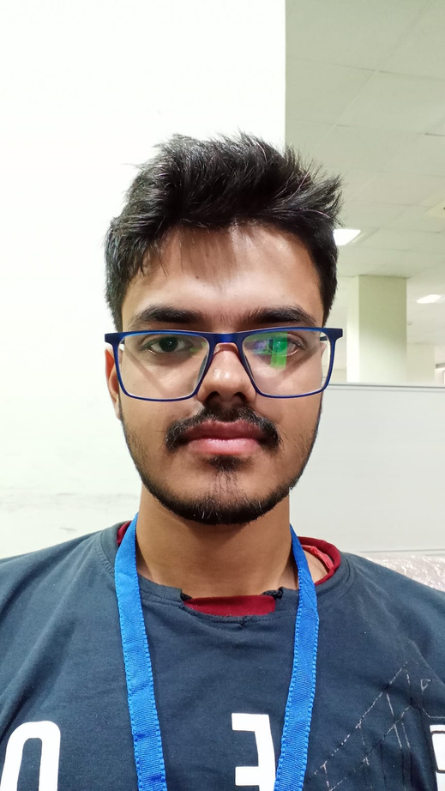
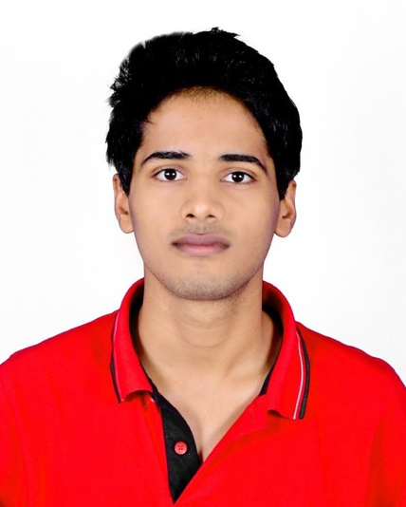
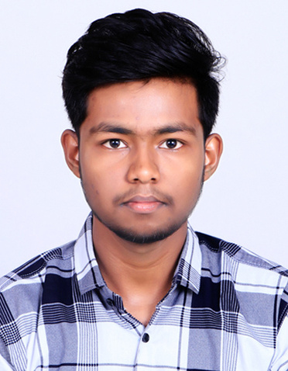
Meet the Team
Sumit Soni
Shrey shukla
Adarsh Sahu
ECE, NIT Raipur
ECE, NIT Raipur
MME, NIT Raipur

Slide 8
THANK YOU

